Slide 1


+++ Live +++ +++ Live +++ +++ Live +++
Welcome
to
Software Engineering
Lesson WS2020/2021
Starting at 14:15
survey

Slide 2

+++ Live +++ +++ Live +++ +++ Live +++
The rule No1
Keep your camera on

Slide 3

+++ Live +++ +++ Live +++ +++ Live +++
Software Engineering
WS-2020-2021
Lesson Mo. 14.15-17.45 h Lab: Thur. 14.00-16.00 h
Room 8-103
https://www.linkedin.com/groups/8689804/

Slide 4


Working with Settings
Working with Threads
Damir Dobric
Microsoft PTSP (Partner Technical Solution Specialist) Microsoft Most Valuable Professional
Blog
Twitter
damir.dobric@daenet.com b-dadobr@microsoft.com

Slide 5
Settings

Slide 6
How to read settings (configuration)?
{
"Setting1": "Hello :)",
"Setting2": 123,
"Setting3": 7.21
}
myprogram.exe --Setting1 xy
private static ConfigurationBuilder m_Builder;
private static IConfigurationRoot m_Config;
public static void Main(string[] args) {
m_Builder = new ConfigurationBuilder();
m_Builder.AddJsonFile(“MySettings.json”);
m_Builder.AddCommandLine(args);
m_Config = m_Builder.Build();
Console.WriteLine(m_Config[“Setting1”];
}

Slide 7
How to read section settings?
{
"Setting1": "Hello :)",
"Setting2": 123,
"Setting3": 7.21,
"SubSettings": {
"Setting1": "Hello from sub settings :)",
"Setting2": 123444,
"Setting3": 777.21
}
}
private static ConfigurationBuilder m_Builder;
private static IConfigurationRoot m_Config;
public static void Main(string[] args) {
m_Builder = new ConfigurationBuilder();
m_Builder.AddJsonFile(“MySettings.json”);
m_Config = m_Builder.Build();
Console.WriteLine(m_Config.GetSection(“section”)[“Setting1”];
}

Slide 8
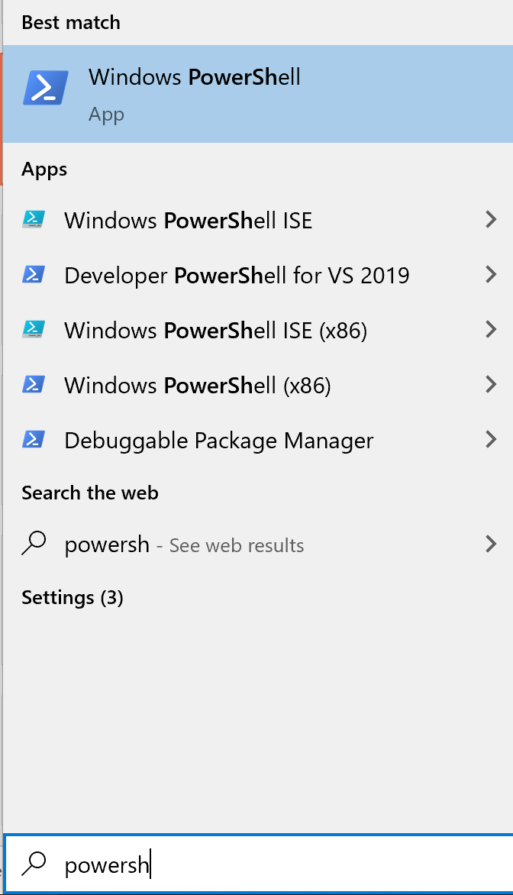
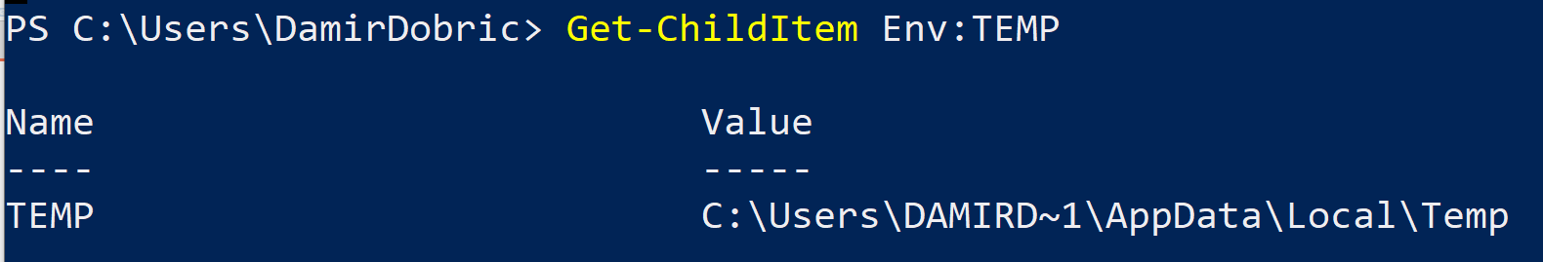
Environment Variables
Open Powershell and execute this to show all variables in environment
Get-ChildItem Env:
Show specific variable

Slide 9
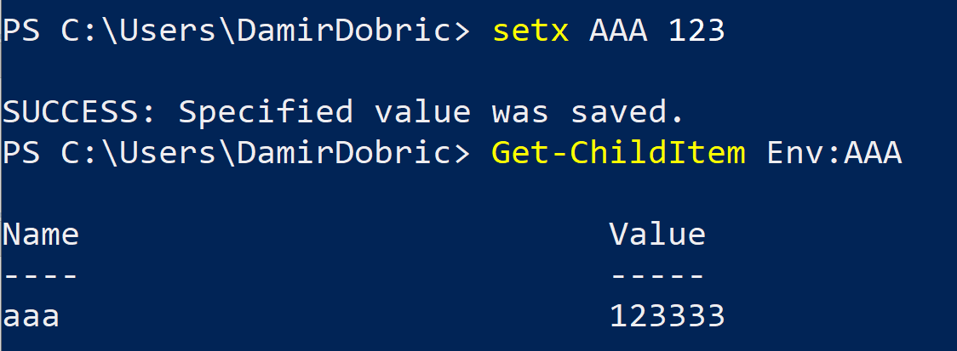
Environment Variables
Create new variable with name ‘AAA’ and value 123.
Read the value of ‘AAA’

Slide 10
Interfaces

Slide 11
Interfaces
Interface is a contract.
It does not execute. It defines what to do.
You always need implementation of an interface
There might me multiple implementations of the same interface
public interface IMyInterface {
object GetResult();
void Train(double[] data);
}

Slide 12
Working with Threads
Parallel & Concurrent execution

Slide 13
Sequential vs. Parallel processing
Sequential
Concurrent
Parallel
Multithreaded

Slide 14
Sequential Execution
for (int i = 0; i < 100; i++)
{
doAnything(null);
}

Slide 15
Multithreading
for (int i = 0; i < threads; i++)
{
var t = new Thread(new ParameterizedThreadStart(doIt));
t.Name = i.ToString();
t.Start(new Action<string>(onThreadFinished));
}
private static void doIt(object onFinishDelegate)
{
doAnything(null);
}

Slide 16
Task Parallel Execution
List<Task> tList = new List<Task>();
for (int i = 0; i < threads; i++)
{
var t = new Task(doIt, “some object”);
tList.Add(t);
}
foreach (var t in tList)
{
t.Start();
}
Task.WaitAll(tList.ToArray());
private static void doIt(object someObjectSate)
{
// . . .
}

Slide 17
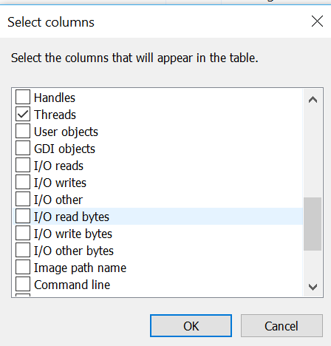
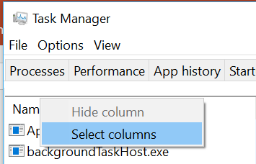
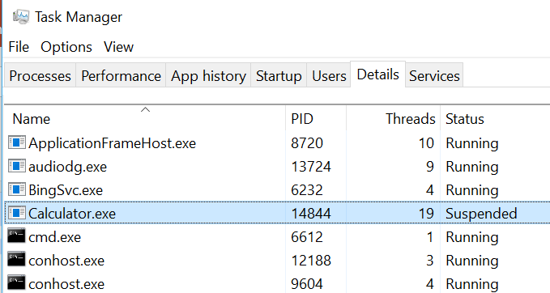
Task Manager

Slide 18
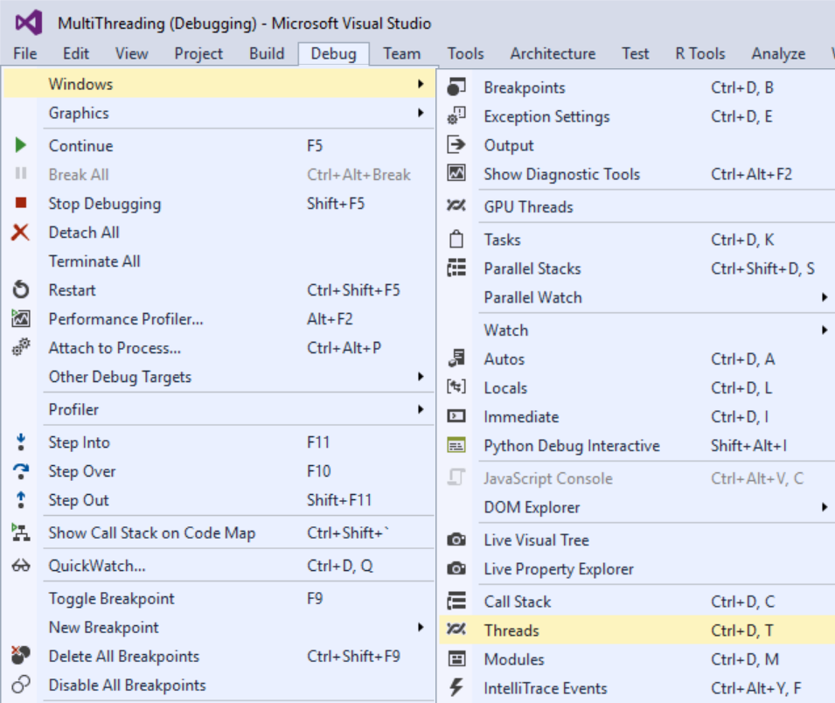
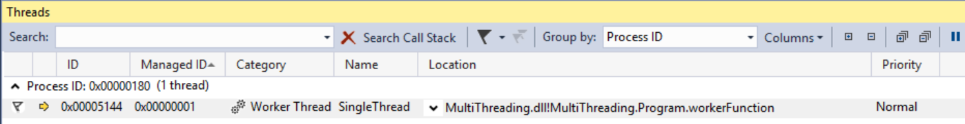
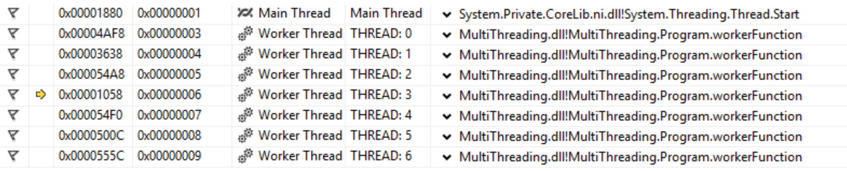
Threads in Visual Studio

Slide 19
Exercises
E7 - Reading configuration
E8 - Interfaces and Classes
E9 - Parallel Processing and Concurrency

Slide 20
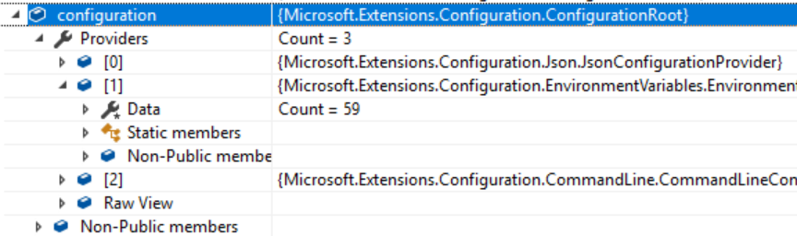
Exercise E7 – Reading Configuration
Add nugets:
Microsoft.Extensions.Configuration
Microsoft.Extensions.Configuration.Binder
Microsoft.Extensions.Configuration.EnvironmentVariables
Microsoft.Extensions.Configuration.FileExtensions
Microsoft.Extensions.Configuration.Json
Microsoft.Extensions.Configuration.CommandLine
Add new file ‘appsettings.json’ to the project
Next slide shows an example.
Add Code for reading settings
See next slides for example.

Slide 21
appsettings.json
{
"Setting1": "Hello :)",
"Setting2": 123,
"Setting3": 7.21,
"SubSettings": {
"Setting1": "Hello from sub settings :)",
"Setting2": 123444,
"Setting3": 777.21
},
"MySetting": {
"SomeInt": "77",
"SomeString": "Hello :)",
"SomeFloat": 12.1
}
}

Slide 22
Sample Code
static void Main(string[] args)
{
var builder = new ConfigurationBuilder()
.SetBasePath(Directory.GetCurrentDirectory())
.AddJsonFile("appsettings.json", optional: false, reloadOnChange: true)
.AddEnvironmentVariables();
if (args != null) { builder.AddCommandLine(args);
}
IConfigurationRoot configuration = builder.Build();
// // Following are comming from command line. var color = configuration["color"]; var fontSize = configuration["fontSize"]; }

Slide 23
Exercise E8 – Interfaces and Classes
Define some interface or use IMyInterface from this presentation. (See slide 9)
Create two classes, which implement interface by using two different approaches. For example:
Method train could calculate sum of all values specified in data and set result to 1 if the sum is greater than 100 and 0 if sum is less than 100.
Second implementation could use some different rule. For example Train would calculate Average value, Median and Variance. All named results can be provided as properties of some class called Result. Method GetResult would return instance of class Result.
Please note that method Train can be called multiple times. It means implementation of interface must remember calculated result.
3. Extend interface with methods Save and Load. Save should save currently calculated (trained) result and Load should load saved result on next application start

Slide 24
E9 - Parallel Processing and Concurrency 1/2
Run a job in Sequence
Execution job after job.
Run every job in its own thread
Optimal: If number of processors (cores) equals num. of threads.
Context switches: if num. of threads higher than num of processors (cores).
OS need time for managing of context switches.
Run jobs as parallel Tasks
Internal scheduler fires optimal num. of threads
Internal scheduler reuses threads.

Slide 25
E9 - Parallel Processing and Concurrency 2/2
Implement your own worker.
Provide test results as diagrams in Excel for all 3 approaches
Outputs
Execution time
Max number of threads during execution
Excel Diagram
Inputs:
Test Name (Approach)
Test with numThreads = {50, 100, 150}
Number of processors (Affinity in TaskMgr) {1, 2, 4, ?}

